Slide 1


Generation of mechanistic hypotheses linking signalling and metabolism in cancer with COSMOS
Aurelien Dugourd
Saez-Rodriguez research group

Slide 2
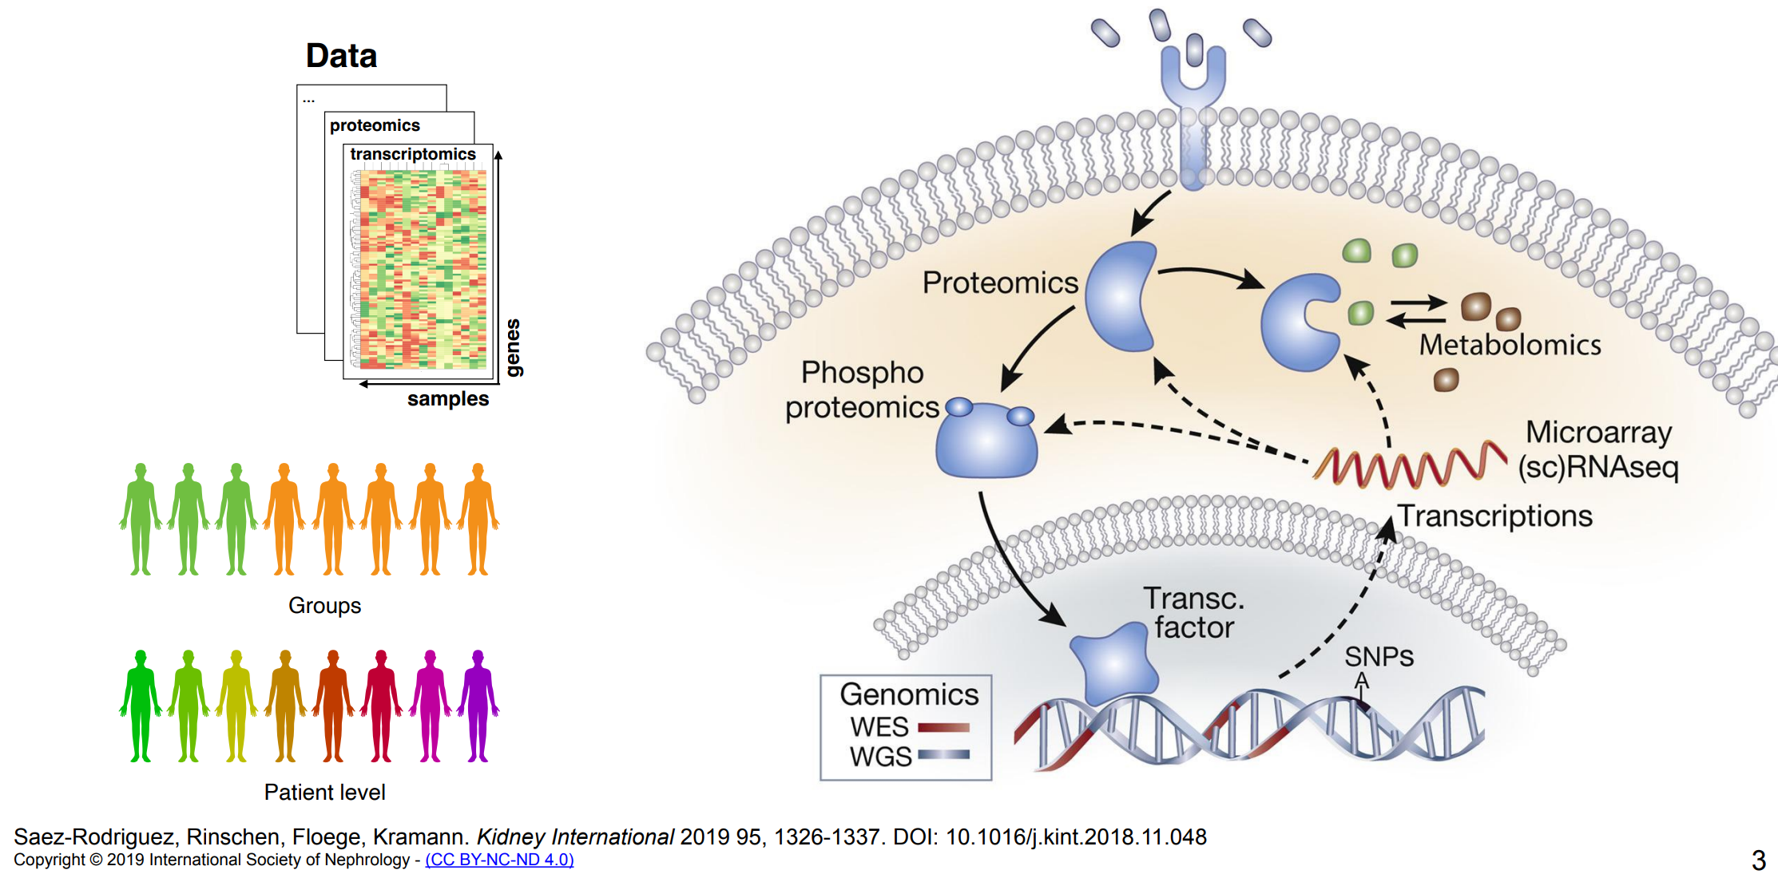
NCI60 RNA + metabolomic factor + cosmos analysis

Slide 3
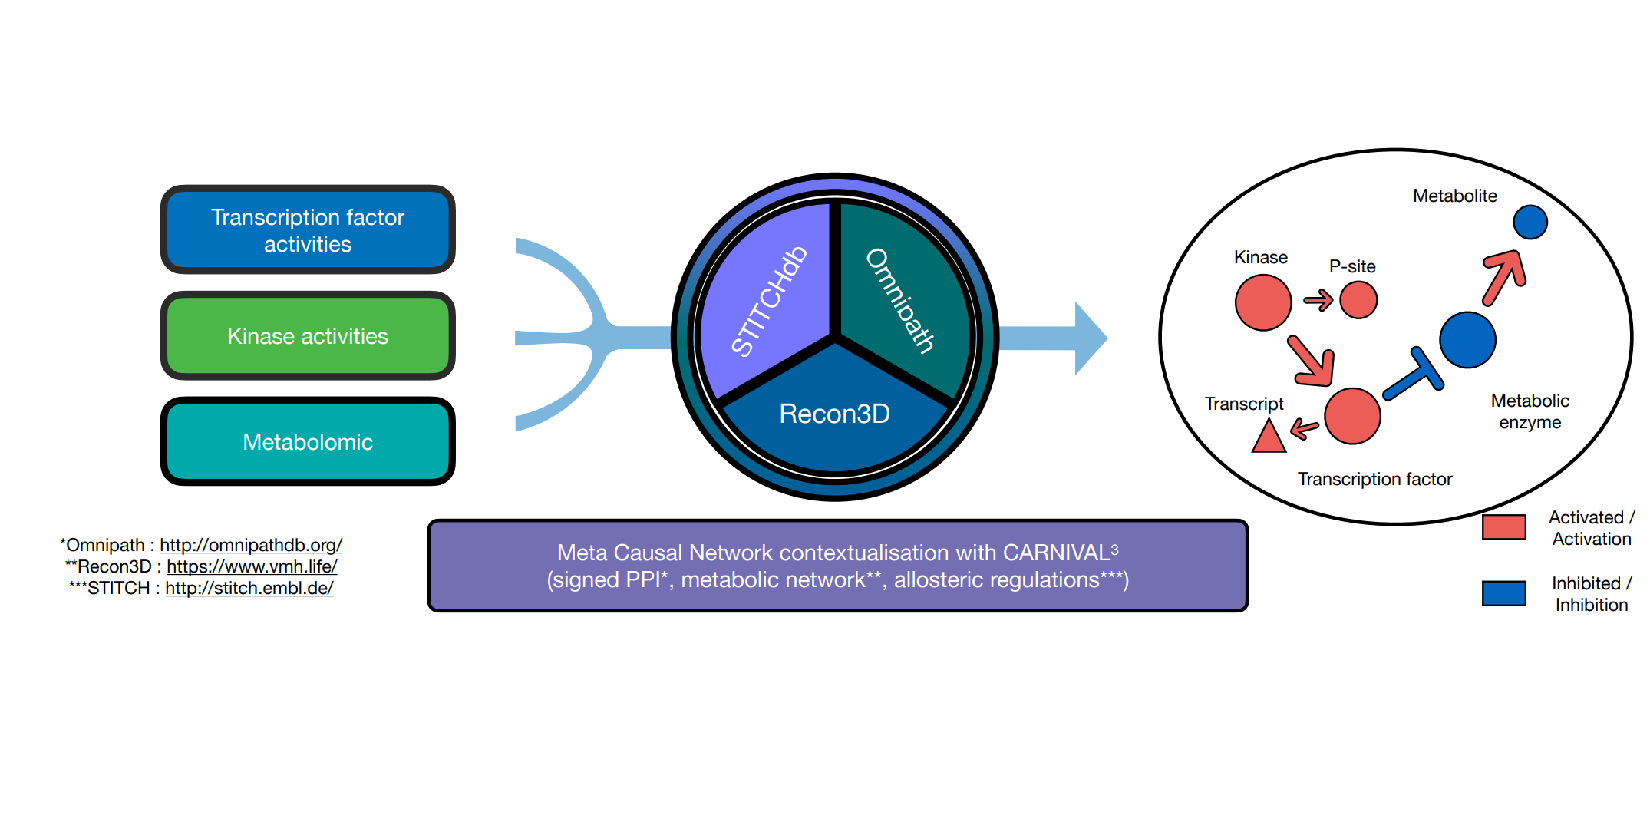
NCI60 RNA + metabolomic factor + cosmos analysis

Slide 4
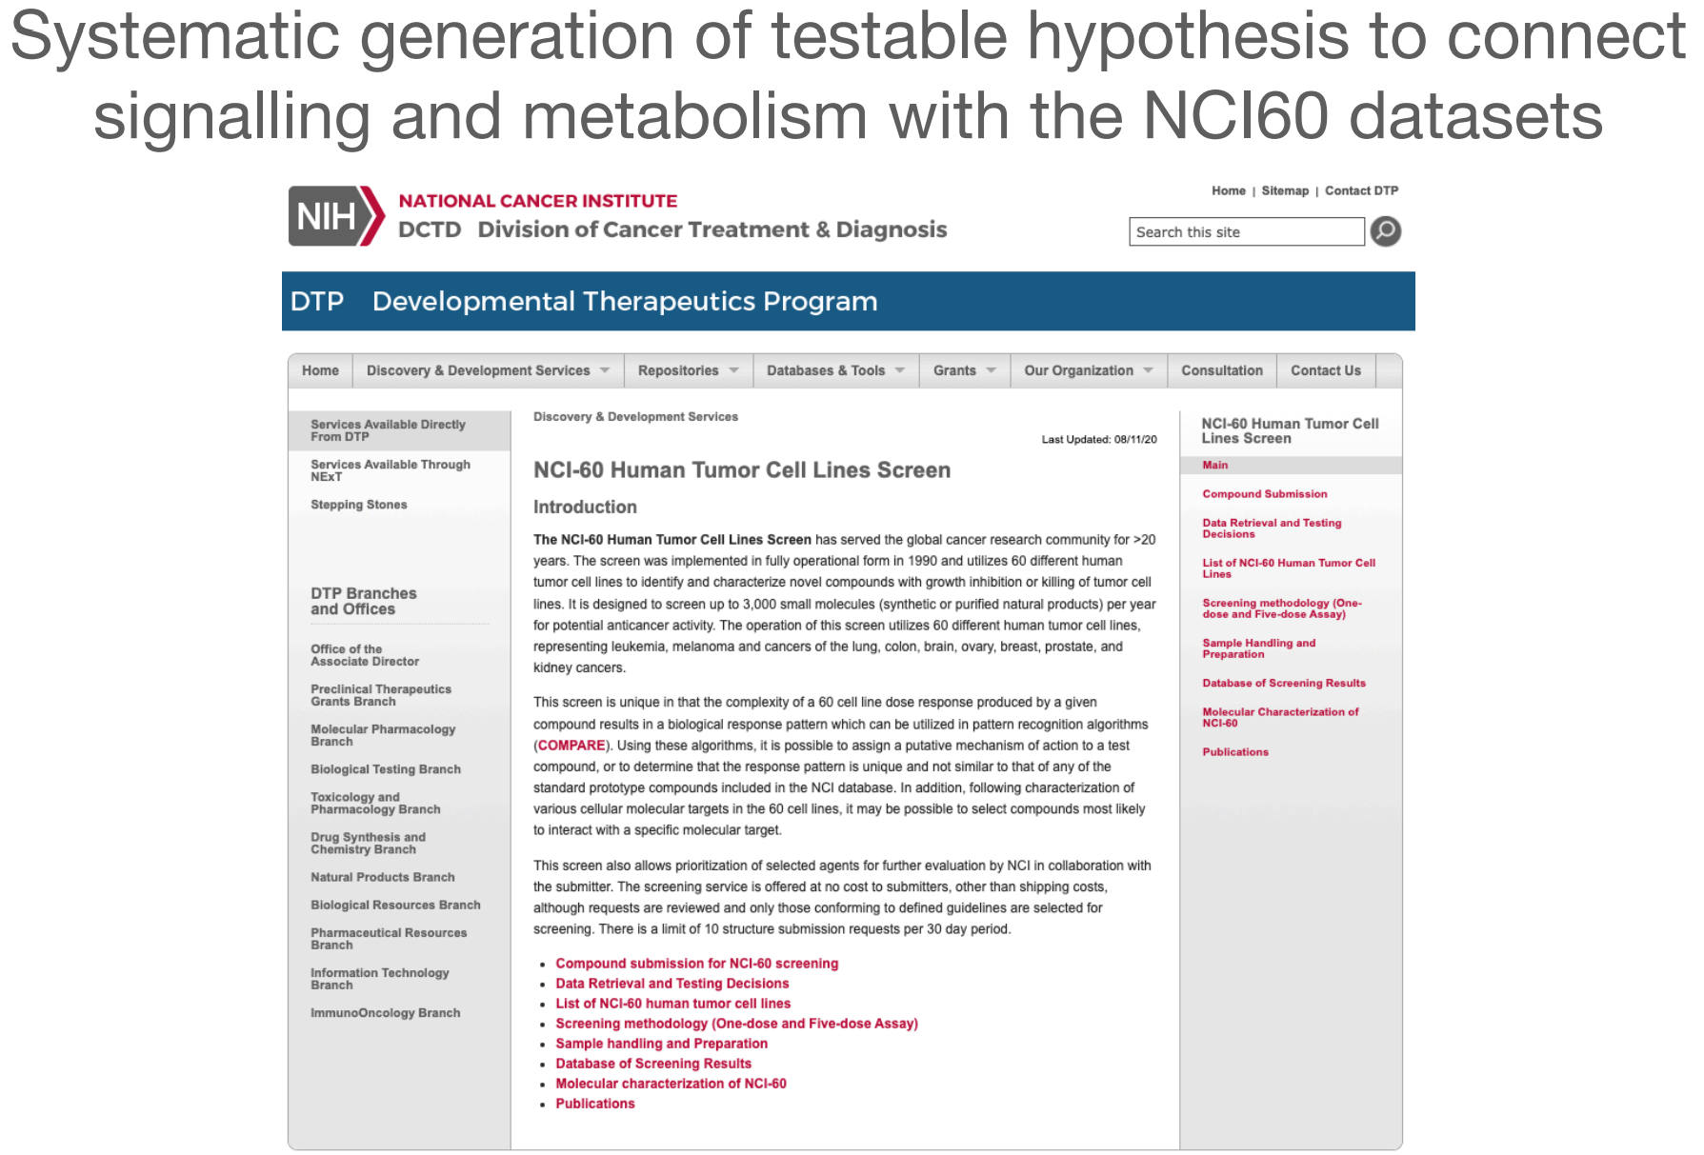
Ocean metabolomic scores compared to proteomic data

Slide 5
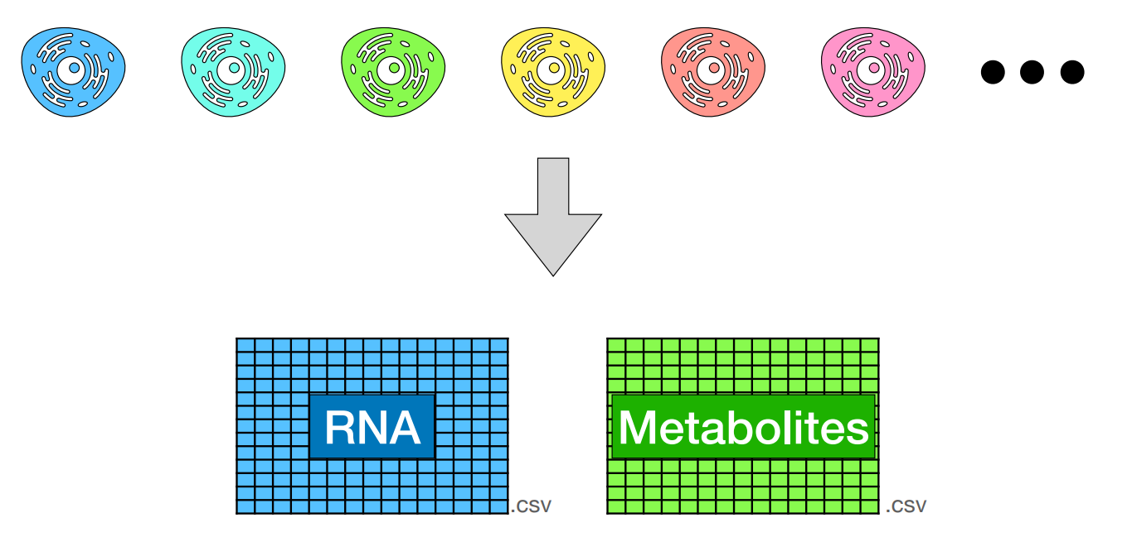
NCI60 cancer cell lines

Slide 6
NCI60 cancer cell lines
Values are z-transformed across cell lines - each value represent how high or low a gene/metab is in a cell line compared to the other cell lines

Slide 7
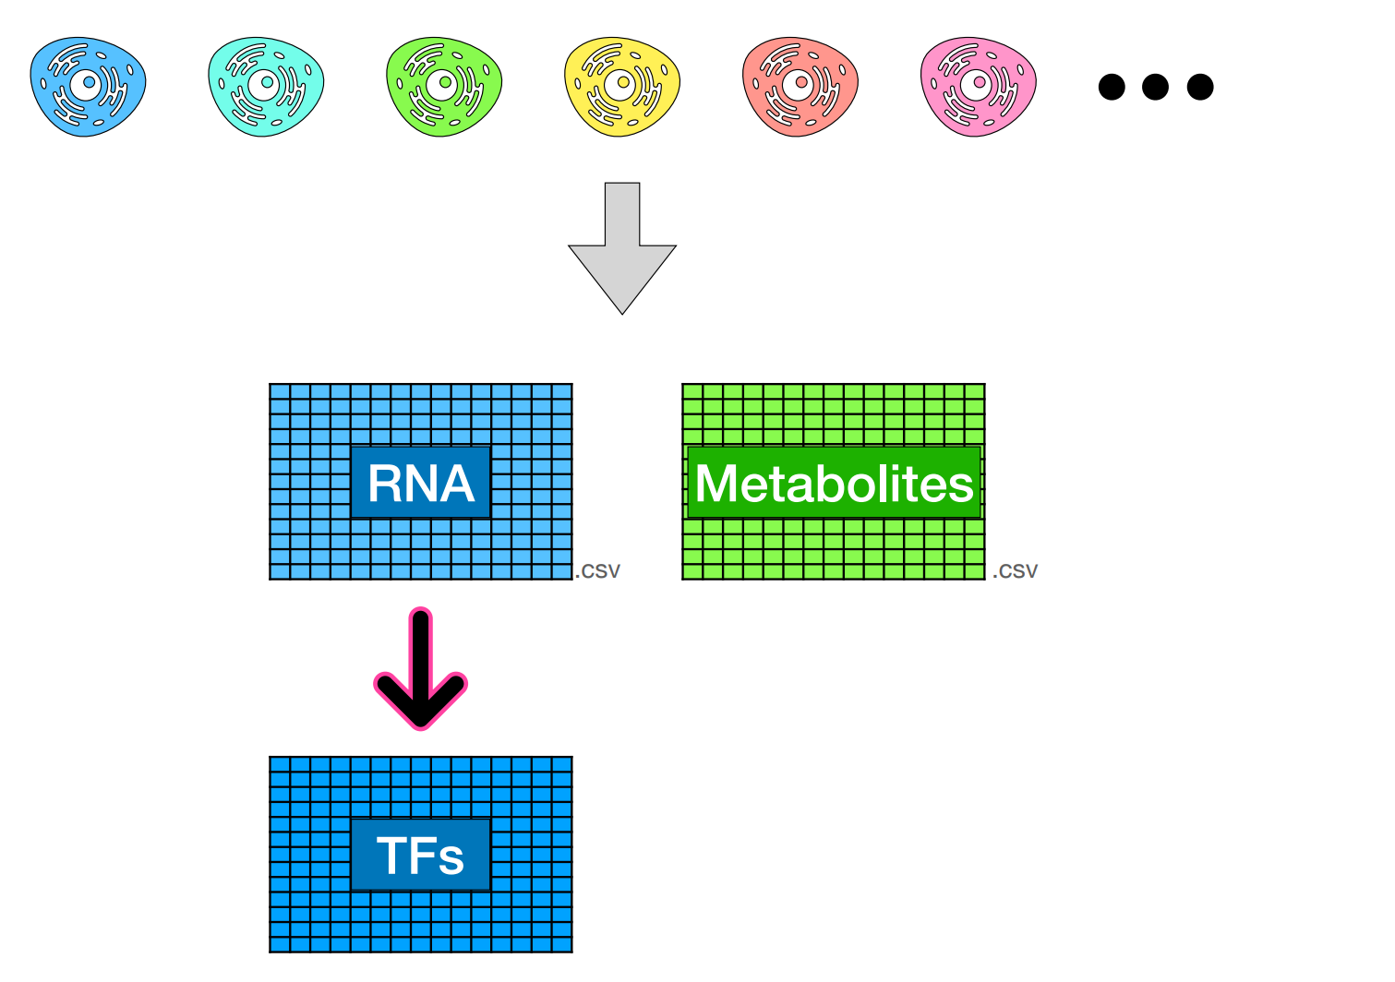
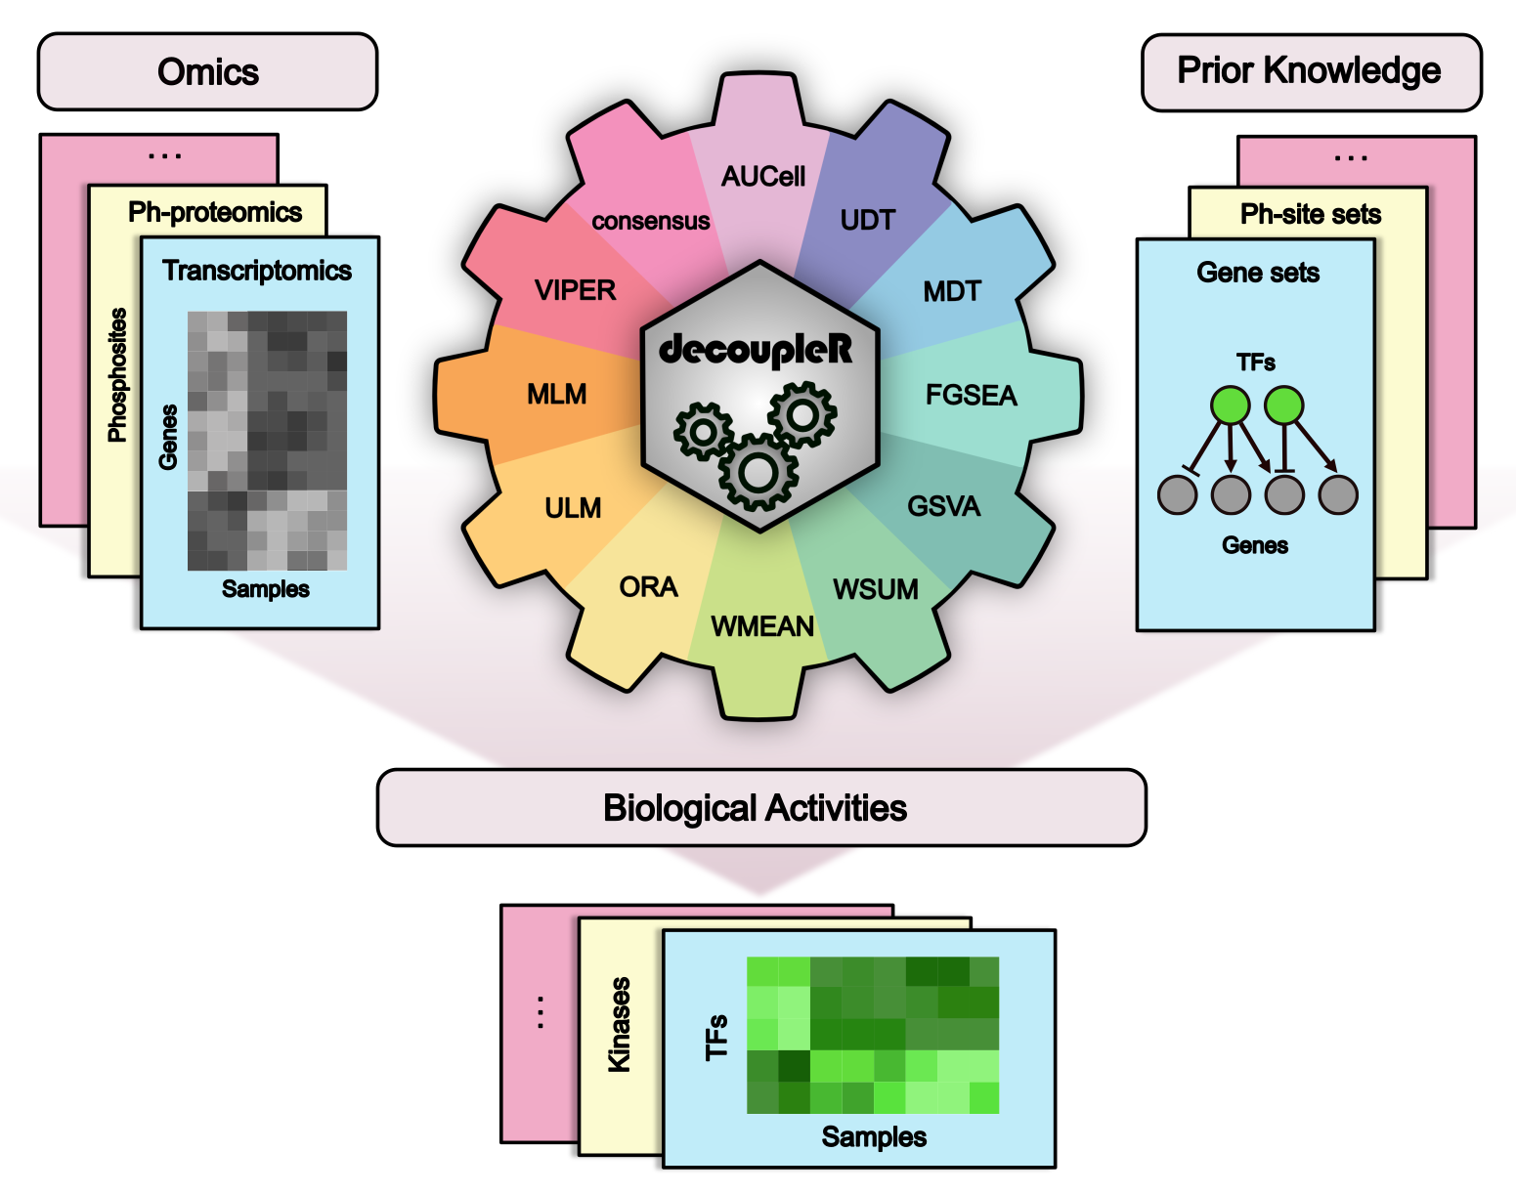
NCI60 cancer cell lines
Badia et al. Bioinfo Advances 2022

Slide 8
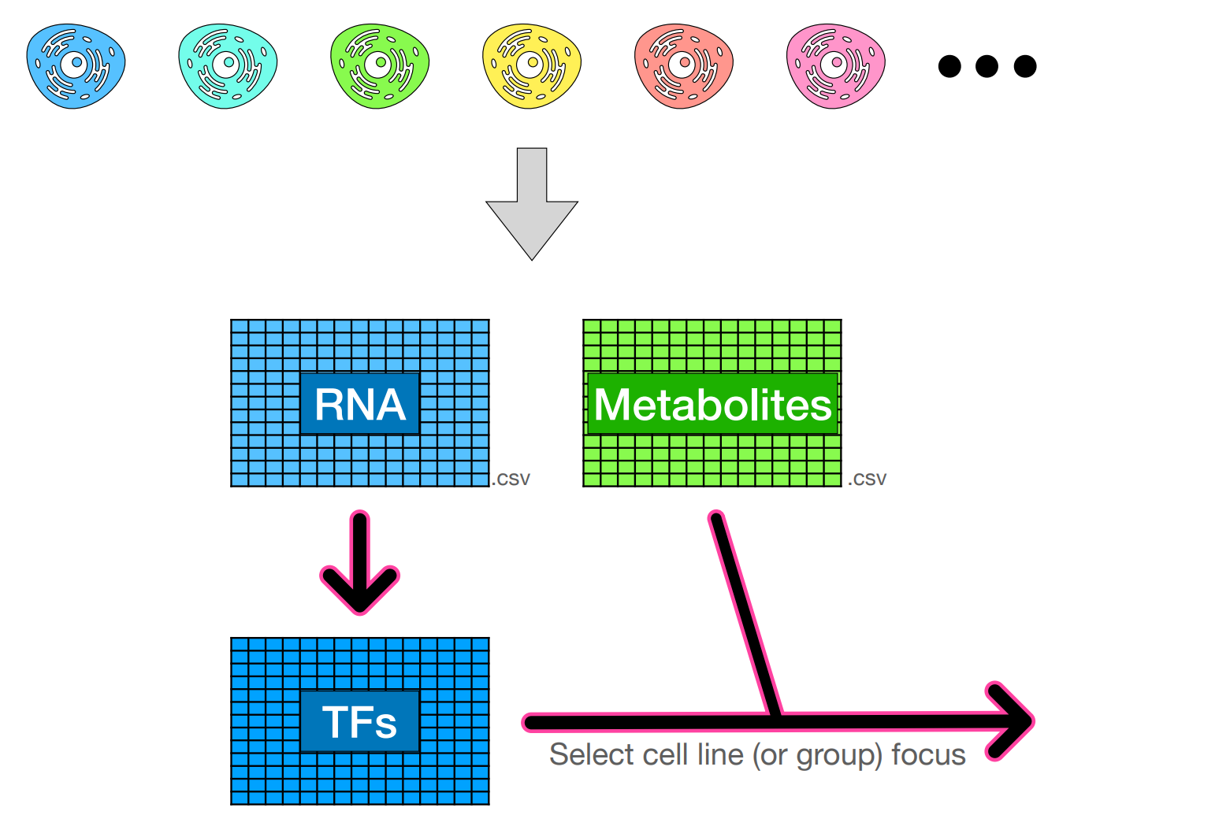
NCI60 cancer cell lines

Slide 9
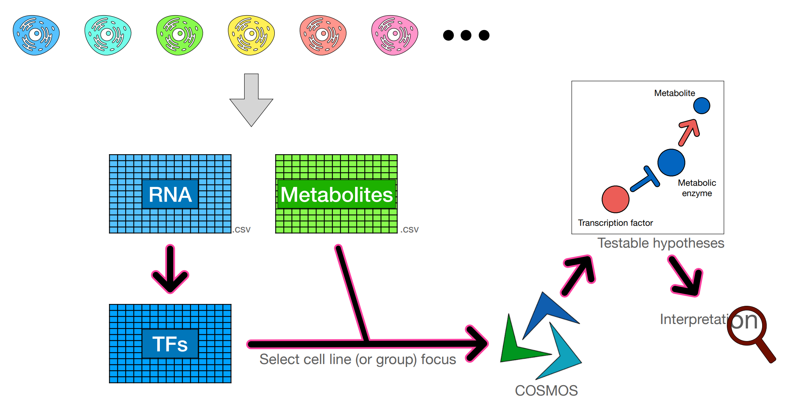
NCI60 cancer cell lines

Slide 10
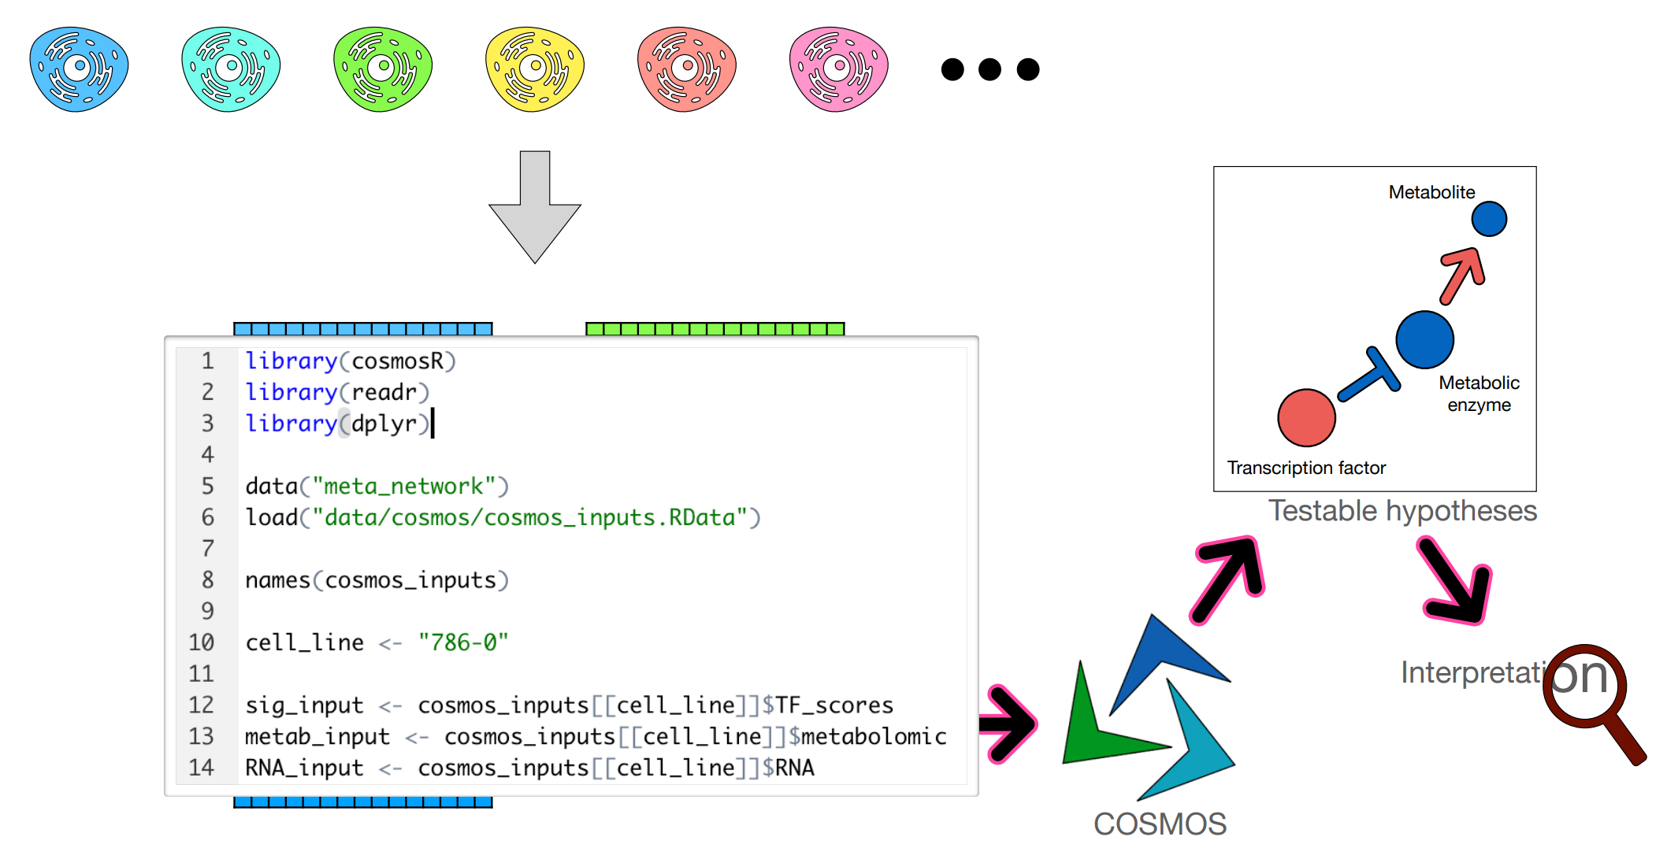
NCI60 cancer cell lines

Slide 11
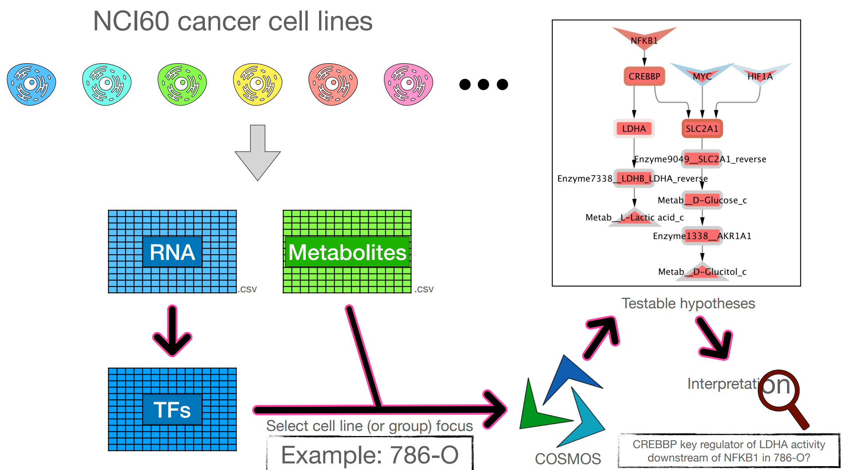
NCI60 cancer cell lines

Slide 12
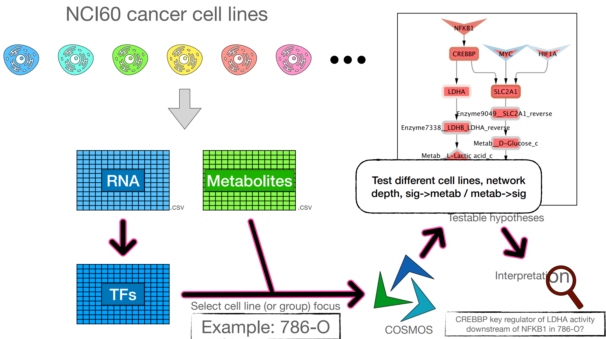
NCI60 cancer cell lines

Slide 13
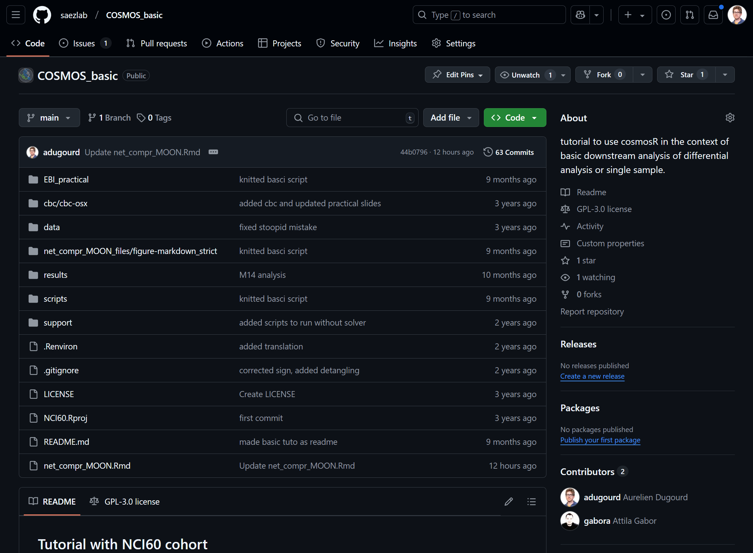
Data and tutorial available on github: https://github.com/saezlab/cosmos_basic

Slide 14
Plan for the days
Day 1 - Discussion, choice of cell line, expected results…
Day 2 - Analysis of first chosen cell line with COSMOS
Day 3 - Analysis of second chosen cell line with COSMOS - comparison to results of first cell line
Day 4 - Interpretation of results and preparation of the presentation

Slide 15
Expected Outcomes
Explore NCI60 cell line omic datasets
Interpreting TF activities estimated from RNA seq data
Learning to use cosmos to integrate signalling and metabolic data with prior knowledge
Generate and interpret testable hypotheses
Understand limits of the method and the interpretation of outputs
Softwares: R 4.1> - cosmosR R package

